Slide 1

Quick Apps Score Repeat Applicants
Presented by:
Oleh Sosnytskyi, Data Science
Update: 04th August 2025

Slide 2
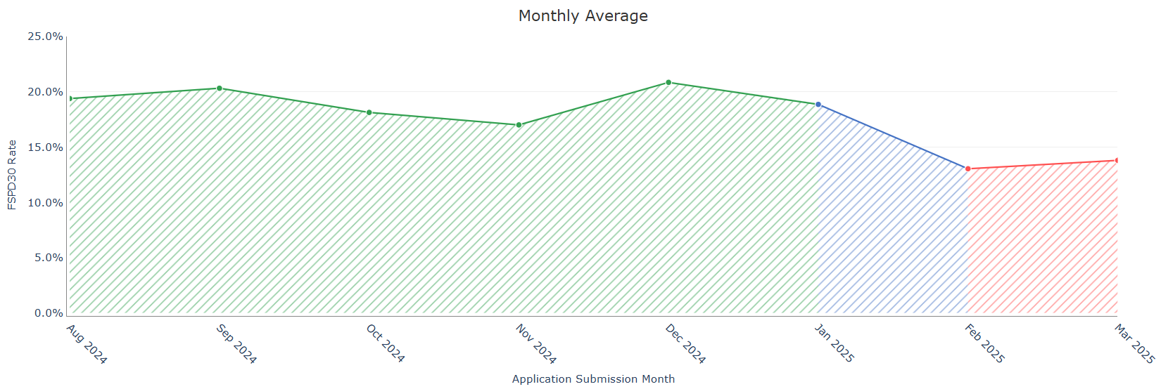
Train-test split. Target definition.
Period | Appication submission dates | # Records | # FSPD30 Count | # FSPD30 Rate
Training* | Aug 13, 2024 – Jan 31, 2025 | 8 687 | 1 650 | 0.19
OOT 1 | Feb 2025 | 391 | 51 | 0.13
OOT 2 | Mar – Apr 16, 2025 | 543 | 70 | 0.13
The training dataset is a combination of New Applicants and Repeat Applicants, as the number of Repeat Applicant records alone is insufficient to build a robust model.
Test periods (OOT1/OOT2) are Repeat Applicants only.
Target: FSPD30

Slide 3
Features: feature selection pipeline
190
Feats
131
Feats
124
Feats
19
Feats
8*
Feats
IV > 0.001 (num)
IV > 0.02 (cat)
Pairwise correlation
< 0.9
Stable feature patterns across train/test/oot periods
Final feature set
So, in the end, all selected features are those that: 1. do not have high correlation
2. do not have high % of missed values
3. do not have rare categories
4. stable correlation with target across all periods

Slide 4
Selected features. List ordered by feature importance.
# | Feature Name | Description
1 | app_last_payday_install_to_apply_days_binned | Number of days between last payday application installation and application
2 | app_cnt_health_and_fitness_ever_binned | Number of Health & Fitness applications
3 | app_cnt_productivity_ever_binned | Number of Productivity applications
4 | app_cnt_rated_for_18plus_ever_binned | Number of 18+ rated applications
5 | app_cnt_non_ps_app_tag_365d_binned | Number of non-playmarket applications in last 365 days
6 | app_cnt_books_and_reference_ever_binned | Number of Books & Reference applications
7 | app_cnt_gaming_180d_binned | Number of Gaming applications in last 180 days
There is ln_user_type feature (New Applicant/Repeat Applicant) in final feature list, but this feature only needed because we used combined training dataset.
All numerical features were binarized in order to reduce complexity of the model to better catch general patterns for Repeat Applicants.

Slide 5
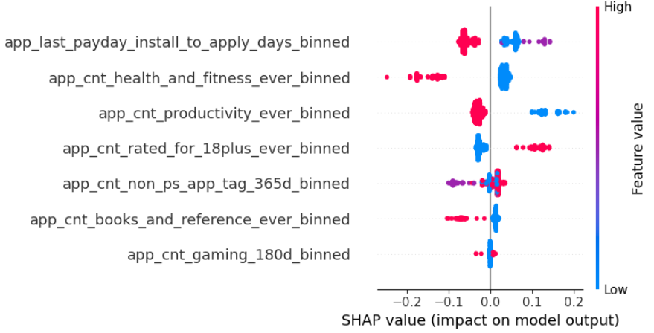
Feature importance of selected features
How to Read this SHAP chart?
Impact on default probability:
Values to the right (positive) → increase probability of default
Values to the left (negative) → decrease probability of default
Features at the top have strongest influence on predicting defaults
Red color means High feature value, Blue color means low feature value, so
Right Red: high values of this feature increases default risk
Left Blue: low values of this feature decreases default risk
Right Blue: low values of this feature increased default risk
Left Red: high values of this feature decreases default risk

Slide 6
CatBoost Model Performance. Incremental Gini Analysis
Model iteration | Features | Train Gini | OOT 1 Gini | OOT 2 Gini
Final features (8 features) | Final features | 0.1914 | 0.2626 | 0.2279
Top 9 features | + app_cnt_shopping_ever_binned | 0.1974 | 0.2407 | 0.1972
Top 10 features | + app_cnt_social_ever_binned | 0.1861 | 0.2127 | 0.1896
Top 11 features | + app_cnt_driver_ever_binned | 0.2406 | 0.2127 | 0.1245
Top 7 features | - app_cnt_gaming_180d_binned | 0.214 | 0.2632 | 0.1973
Top 6 features | - app_cnt_books_and_reference_ever_binned | 0.1802 | 0.2533 | 0.1886
The number of records per testing periods is quite small, so the Gini value could be very volatile
The best number of features based on OOT 1/OOT 2 performance is 8 features

Slide 7
Apps Score Model Performance
Model | Train Gini [Aug 13 – Jan 31] | OOT 1 Gini [Feb 1 – Feb 28] | OOT 2 Gini [Mar 1 – Apr 16] | OOT 3 Gini [FPD30, May 1 – May 16]
CatBoost model | 0.191 | 0.263 | 0.228 | 0.344
DL model | 0.434 | 0.213 | 0.224 | 0.279
Combined model (0.6/0.4 weights) | 0.384 | 0.277 | 0.272 | 0.396
Old model | 0.209 | 0.177 | 0.220 | 0.308

Slide 8
Appendix
​
tonikbank.com

Slide 9
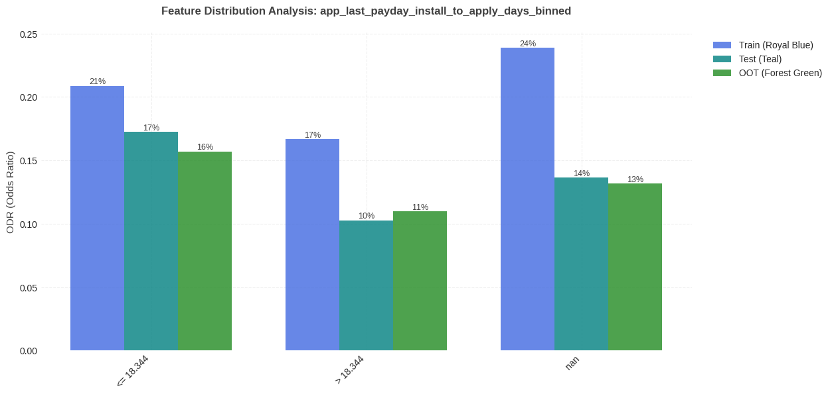
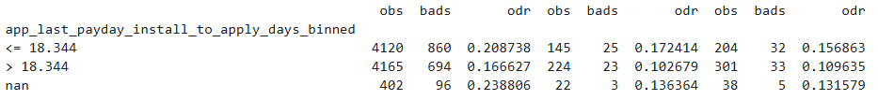
#1 app_last_payday_install_to_apply_days_binned: feature distribution per train/test
There is a trend: lower count corresponds to higher ODR.

Slide 10
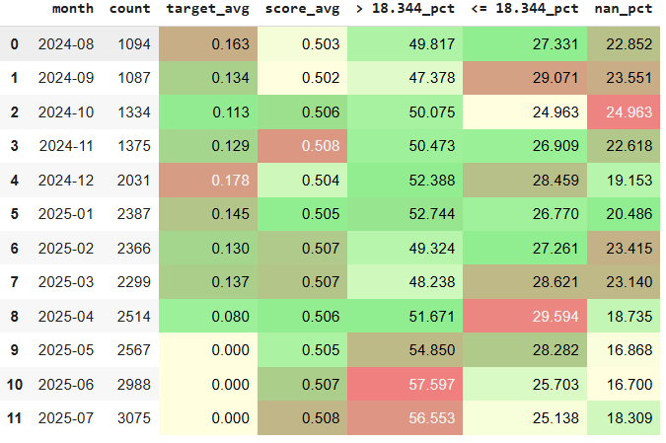
#1 app_last_payday_install_to_apply_days_binned: MoM feature statistic
In recent months, the proportion of high feature values has increased (+5% approx.); however, it cannot be said that this has affected the model's average score

Slide 11
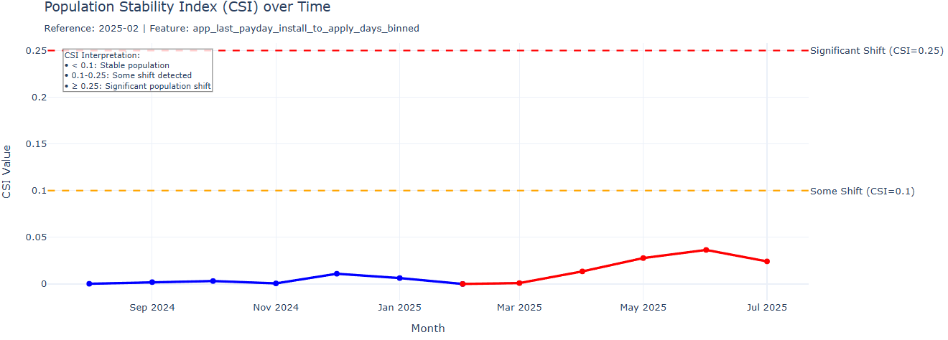
#1 app_last_payday_install_to_apply_days_binned: feature CSI Analysis
The CSI value stayed below 0.1 throughout Aug 2024–Jul 2025, indicating that the feature’s distribution remained largely unchanged and stable.

Slide 12
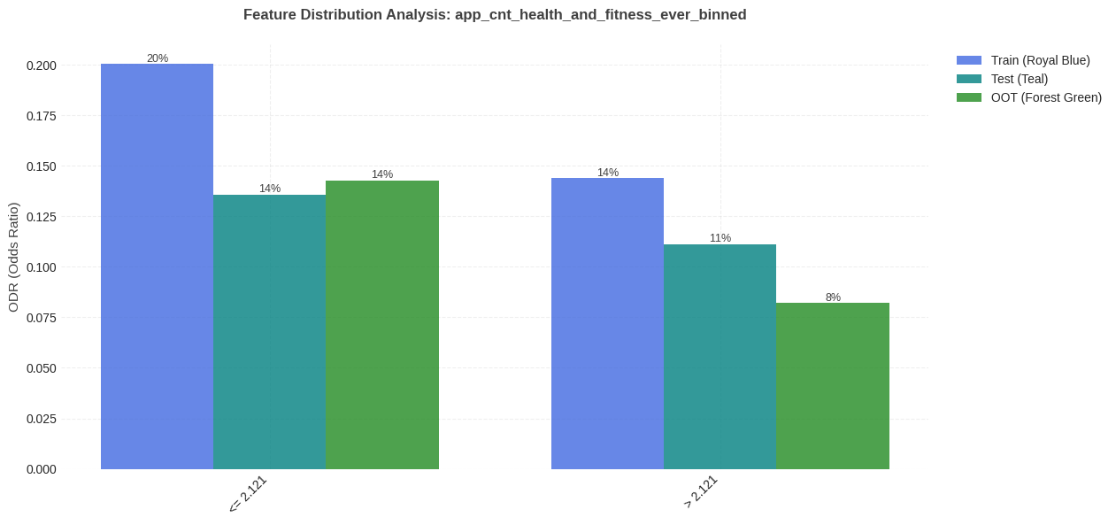

#2 app_cnt_health_and_fitness_ever_binned: feature distribution per train/test
There is a trend: lower count corresponds to higher ODR.

Slide 13
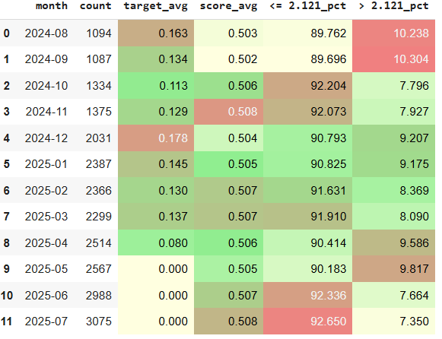
#2 app_cnt_health_and_fitness_ever_binned: MoM feature statistic
The share of high and low feature values remains stable throughout the period under review, with minor fluctuations of approximately ±1%.

Slide 14
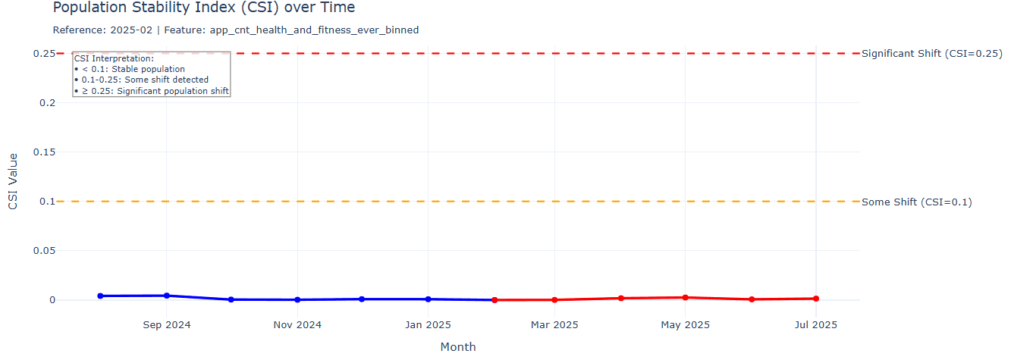
#2 app_cnt_health_and_fitness_ever_binned: feature CSI Analysis
The CSI value stayed below 0.1 throughout Aug 2024–Jul 2025, indicating that the feature’s distribution remained largely unchanged and stable.

Slide 15
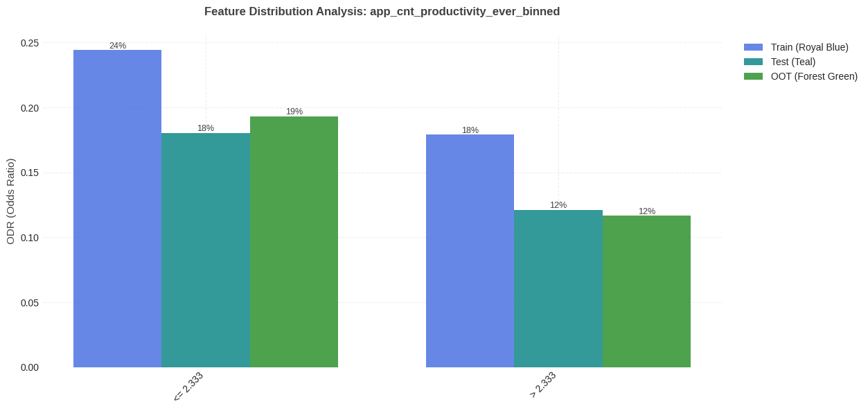

#3 app_cnt_productivity_ever_binned: feature distribution per train/test
There is a trend: lower count corresponds to higher ODR.

Slide 16
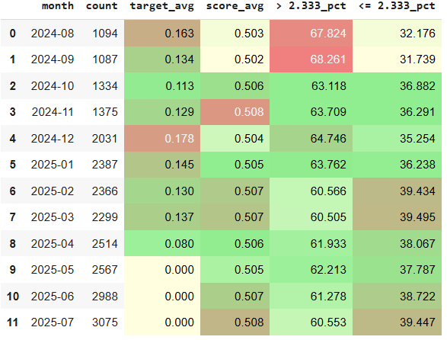
#3 app_cnt_productivity_ever_binned: MoM feature statistic
The share of high and low feature values remains stable throughout the test period, with minor fluctuations of approximately ±1%.

Slide 17
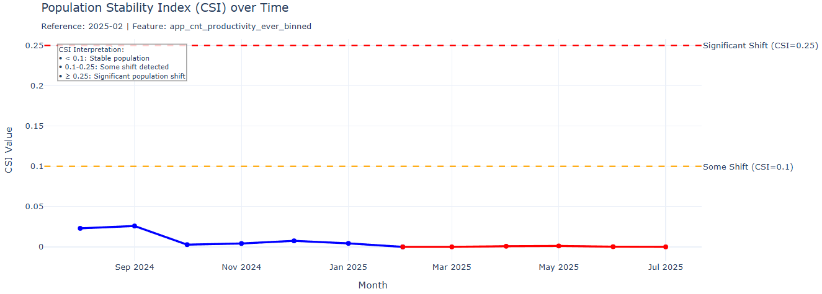
#3 app_cnt_productivity_ever_binned: feature CSI Analysis
The CSI value stayed below 0.1 throughout Aug 2024–Jul 2025, indicating that the feature’s distribution remained largely unchanged and stable.

Slide 18
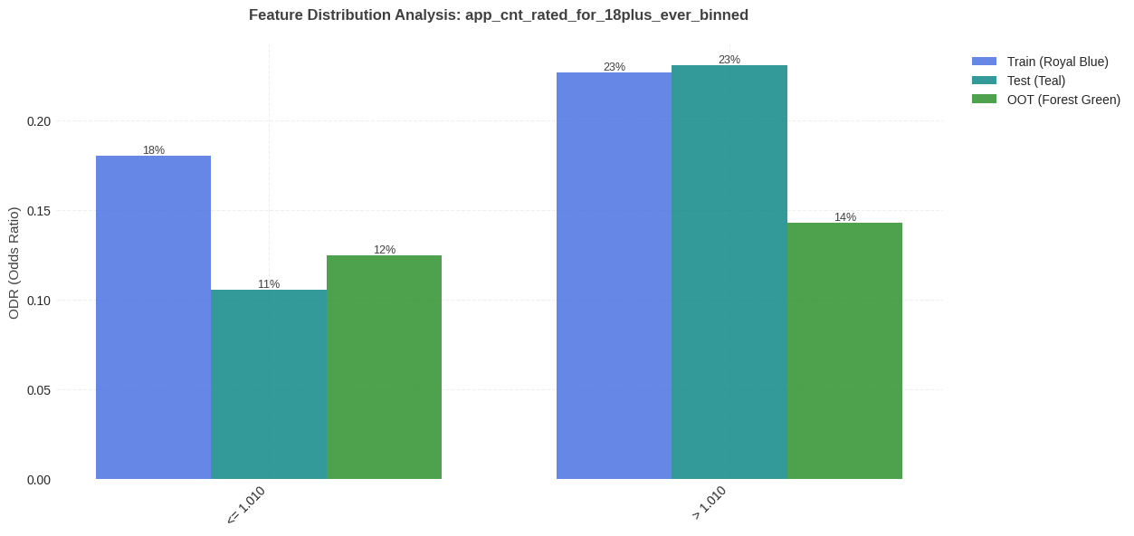

#4 app_cnt_rated_for_18plus_ever_binned: feature distribution per train/test
There is a trend: lower count corresponds to lower ODR.

Slide 19
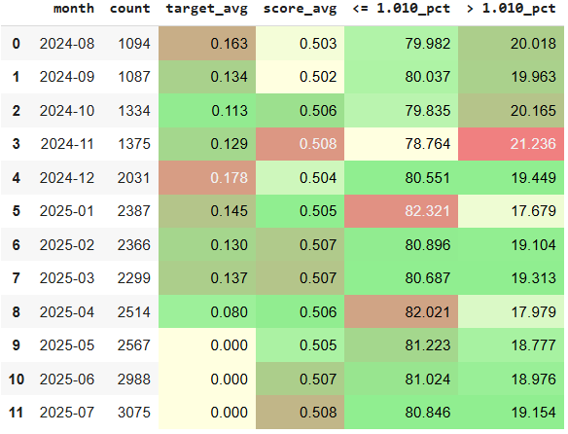
#4 app_cnt_rated_for_18plus_ever_binned: MoM feature statistic
The share of high and low feature values remains stable throughout the period under review, with minor fluctuations of approximately ±1%.

Slide 20
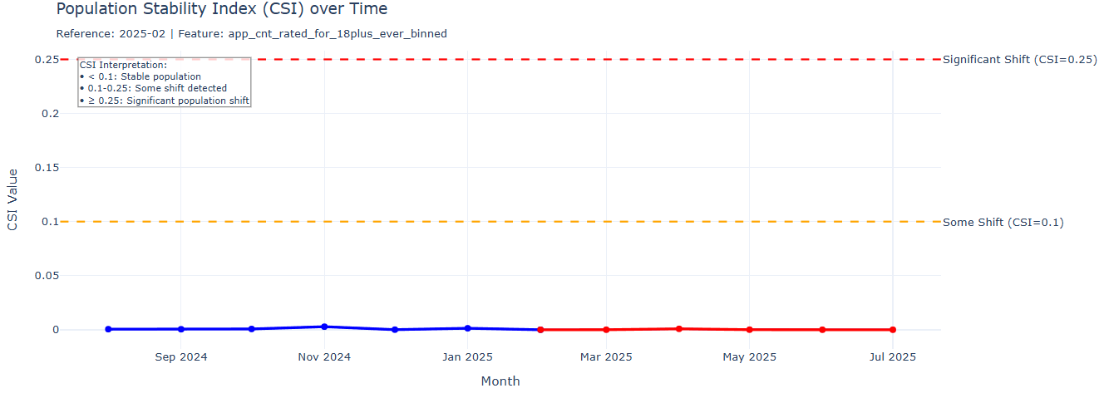
#4 app_cnt_rated_for_18plus_ever_binned: feature CSI Analysis
The CSI value stayed below 0.1 throughout Aug 2024–Jul 2025, indicating that the feature’s distribution remained largely unchanged and stable.

Slide 21
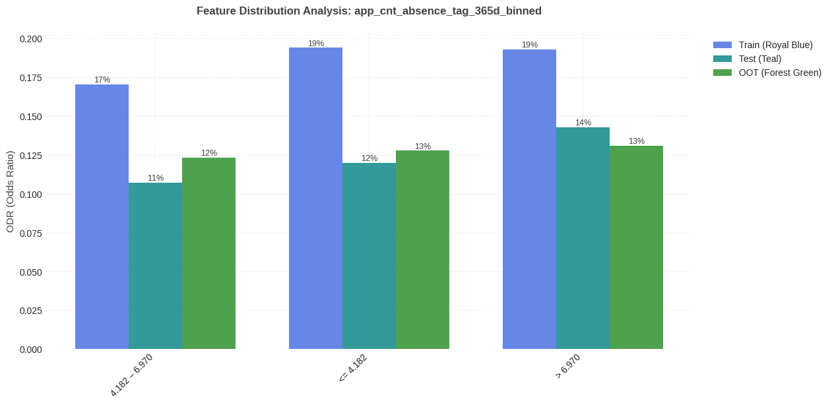
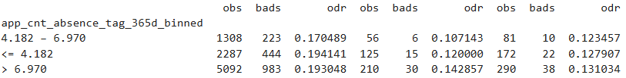
#5 app_cnt_non_ps_app_tag_365d_binned: feature distribution per train/test
There is a trend: lower count corresponds to lower ODR.

Slide 22
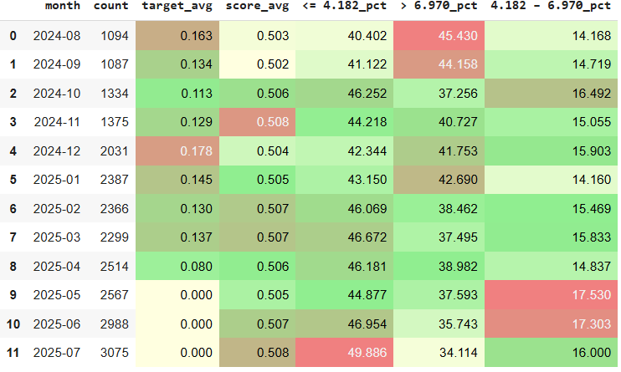
#5 app_cnt_non_ps_app_tag_365d_binned: MoM feature statistic
In July 2025, the proportion of lower feature values has increased (+3% approx.); however, it cannot be said that this has affected the model's average score

Slide 23
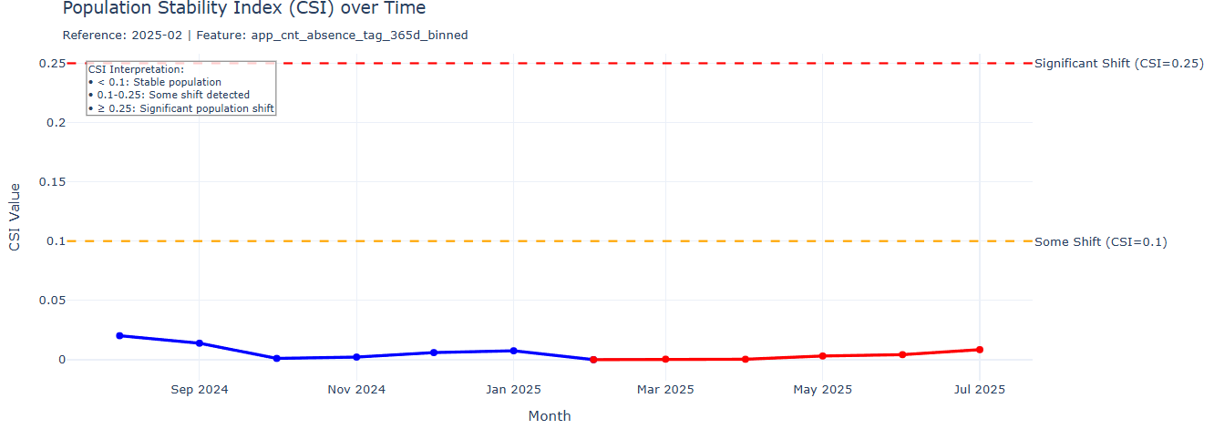
#5 app_cnt_non_ps_app_tag_365d_binned: feature CSI Analysis
The CSI value stayed below 0.1 throughout Aug 2024–Jul 2025, indicating that the feature’s distribution remained largely unchanged and stable.

Slide 24
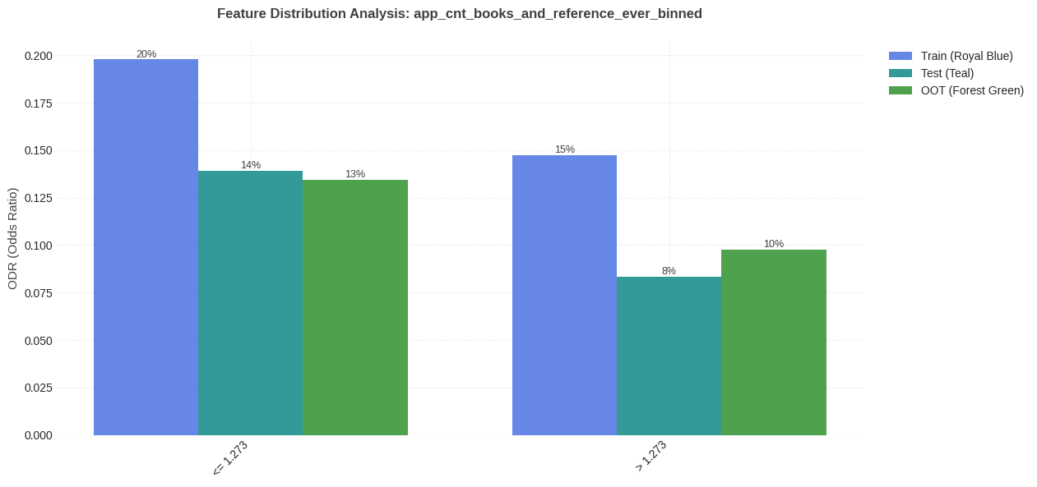
#6 app_cnt_books_and_reference_ever_binned: feature distribution per train/test
There is a trend: lower count corresponds to higher ODR.

Slide 25
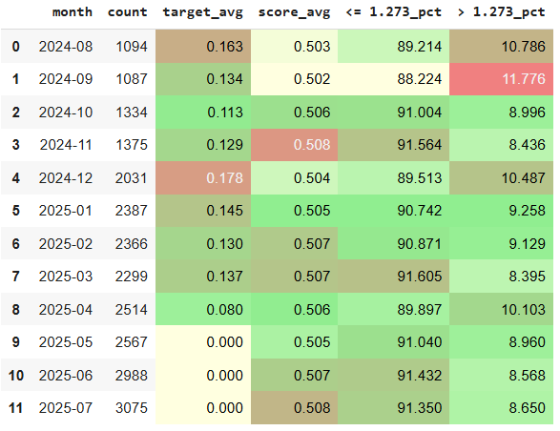
#6 app_cnt_books_and_reference_ever_binned: MoM feature statistic
The share of high and low feature values remains stable throughout the period under review, with minor fluctuations of approximately ±1%.

Slide 26
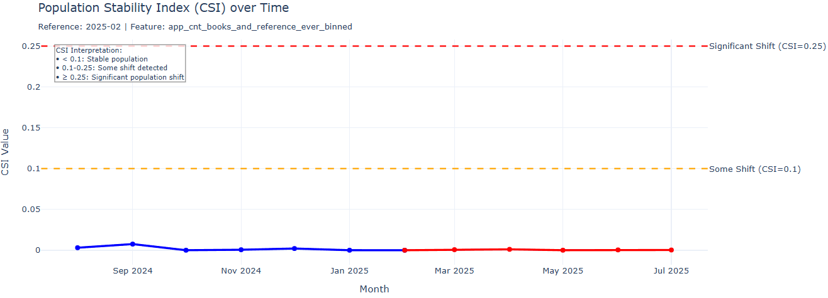
#6 app_cnt_books_and_reference_ever_binned: feature CSI Analysis
The CSI value stayed below 0.1 throughout Aug 2024–Jul 2025, indicating that the feature’s distribution remained largely unchanged and stable.

Slide 27
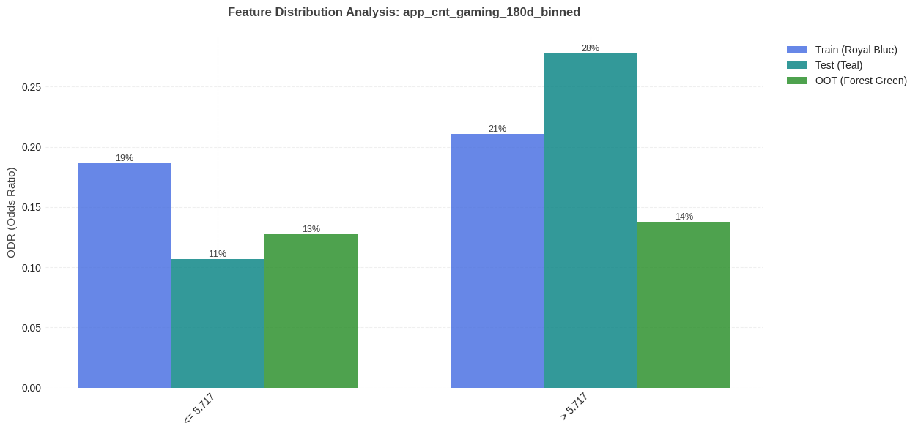

#7 app_cnt_gaming_180d_binned: feature distribution per train/test
There is a trend: lower count corresponds to lower ODR.

Slide 28
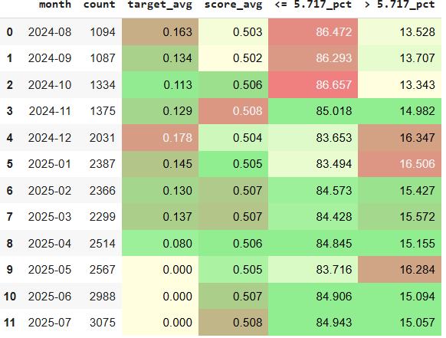
#7 app_cnt_gaming_180d_binned: MoM feature statistic
The share of high and low feature values remains stable throughout the period under review, with minor fluctuations of approximately ±1%.

Slide 29
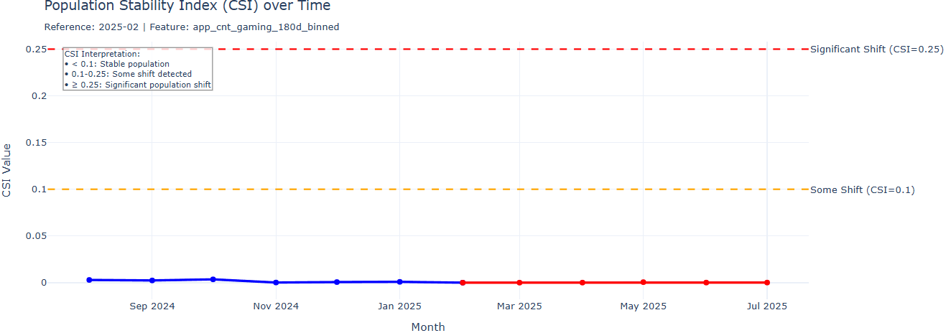
#7 app_cnt_gaming_180d_binned: feature CSI Analysis
The CSI value stayed below 0.1 throughout Aug 2024–Jul 2025, indicating that the feature’s distribution remained largely unchanged and stable.

